Slide 1
Conference Manager*
Overview for teachers
*Configured with PowerSchool Integration for face-to-face conferences

Slide 2
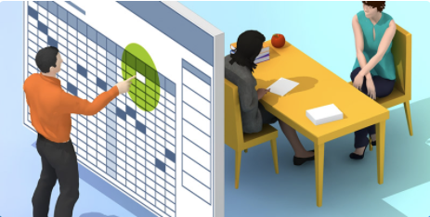
Parent Booking Process

Slide 3
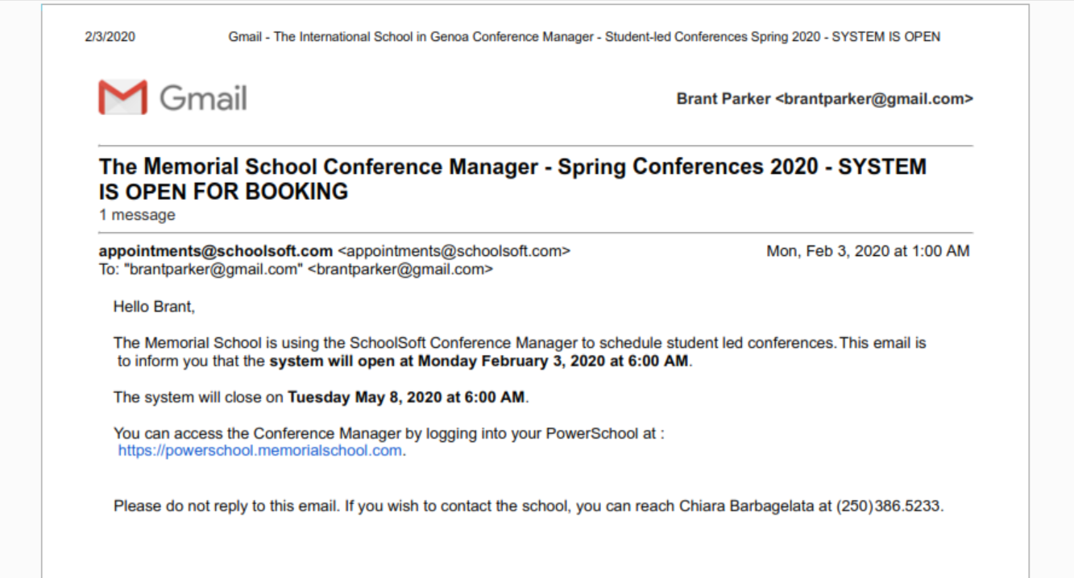
The Memorial School Conference Manager
is open for booking
April 9, 2022 12:05 AM
Memorial School is using the Conference Manager to schedule parent conferences. This email is to inform you that the system will open on Wednesday April 10, 2022 at 8:00 AM.
The system will close on Friday April 29, 2022 at 3:00 AM
You can access the Conference Manager by logging into your PowerSchool account at:
https://memorial.powerschool.com
Please do not reply to this email. If you wish to contact the school, you can reach Heather Fox at 408-555-1212.
Notes:
The Conference Manager is most likely configured to send an email to parents informing them when they can book conferences.

Slide 4
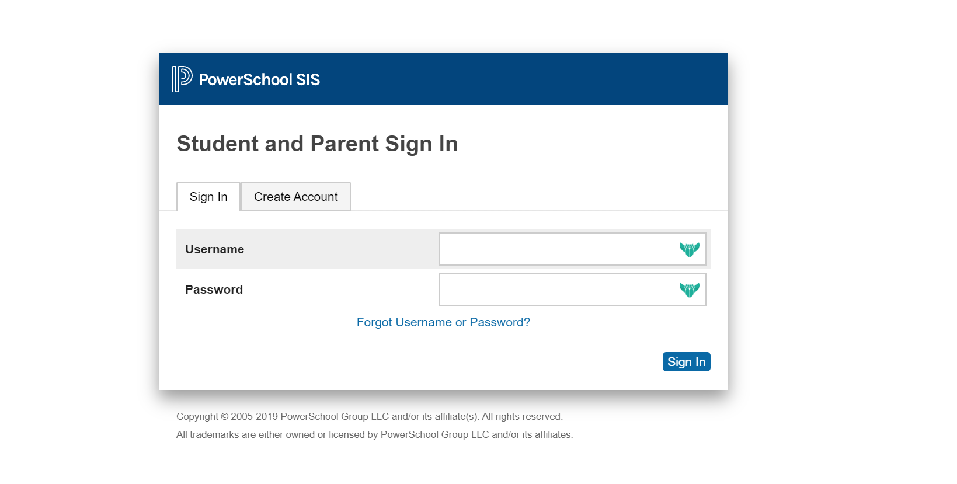
Notes:
Link in the email takes the parent to PowerSchool to log in

Slide 5
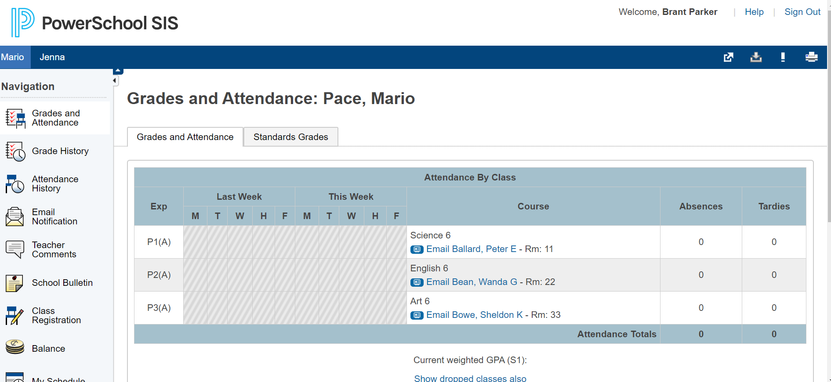
Notes:
This screenshot shows how parents use the application launcher in PowerSchool to access the Conference Manager.

Slide 6
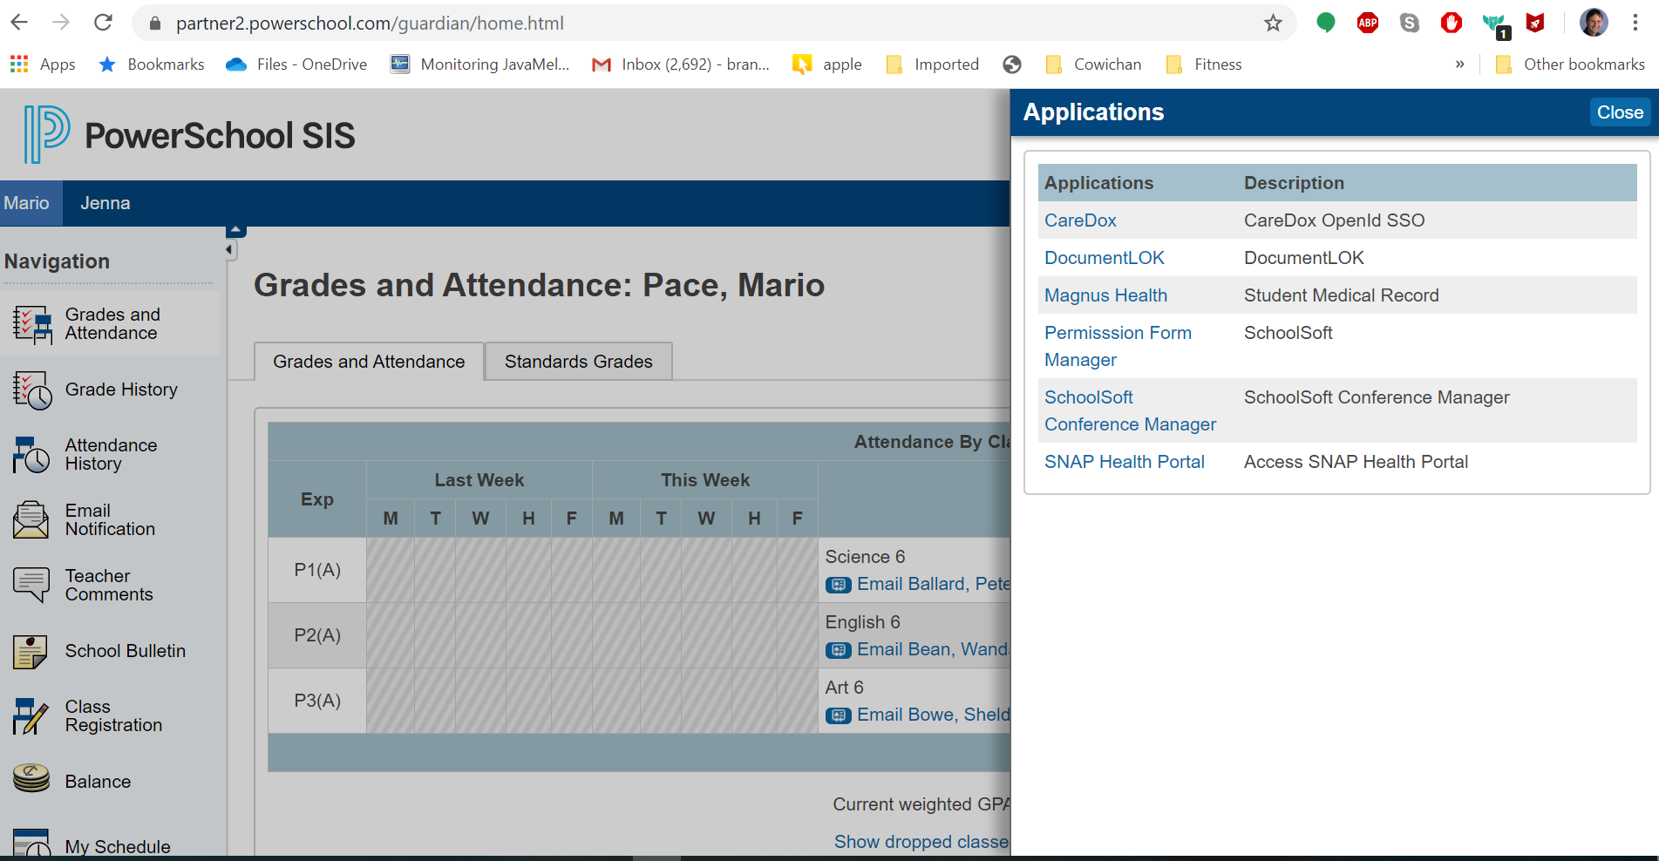
Notes:
And select the Conference Manager from the menu.

Slide 7
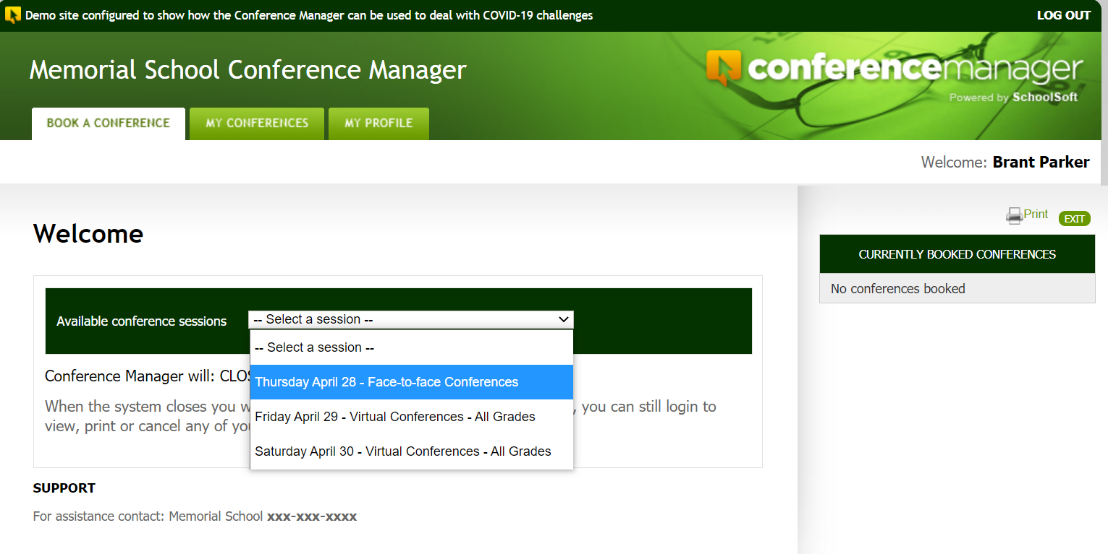
Parents start the booking process by using the conference session drop down list and selecting the date they are interested in making a booking
Notes:
The parent is then in the Conference Manager and can book their appointment(s) by selecting the date they wish to schedule an appointment for. If there are multiple schools in your district using the Conference Manager and the parent has a child in more than one school, after selecting the Conference Manager the parent would see the list of schools their children attend and select the applicable school. A screen shot of the school selection is not included here.

Slide 8
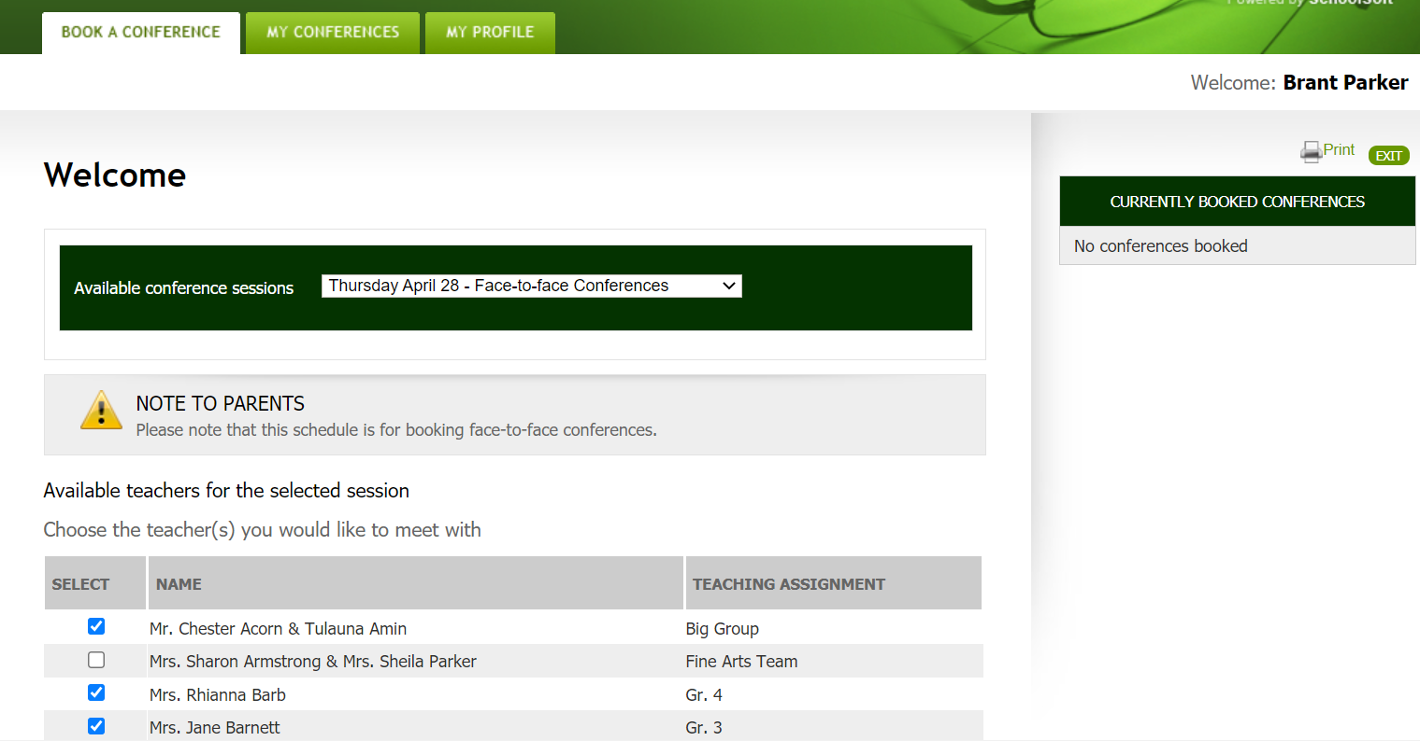
Notes:
Normally, the parent would see only the teachers who are teaching their children this year to select from. They can optionally click a button to view all teachers. They use checks to select the teacher(s) they want to book an appointment with.

Slide 9
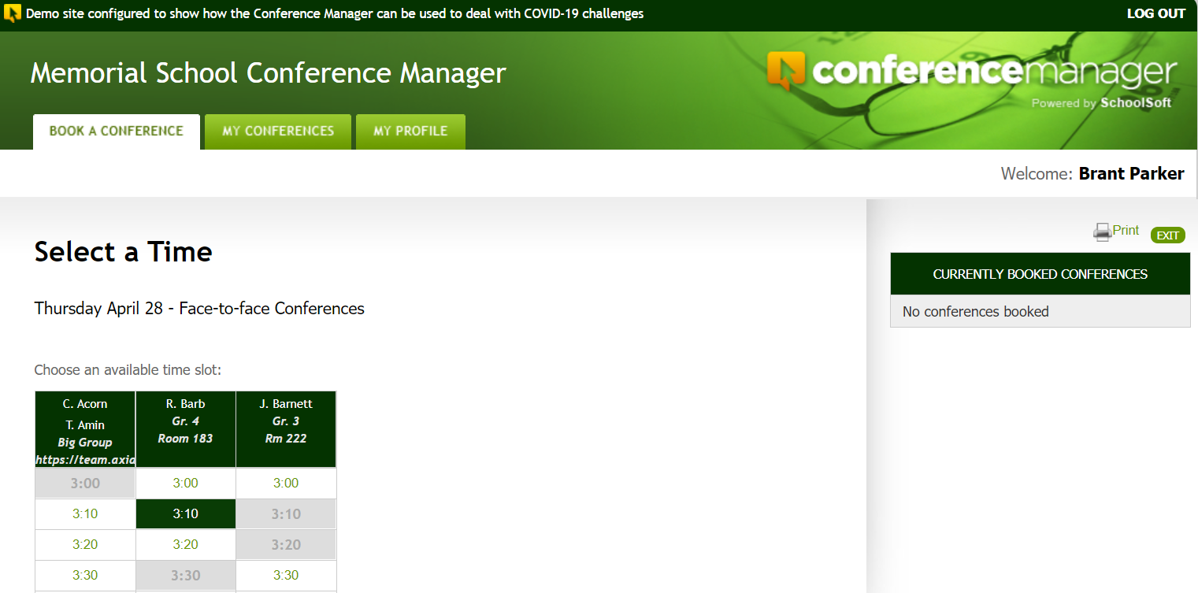
Notes:
The schedules of the teachers are shown. Blocks of time that are booked by other parents or reserved are greyed out. Available blocks can be clicked on and the parent can complete a booking.

Slide 10
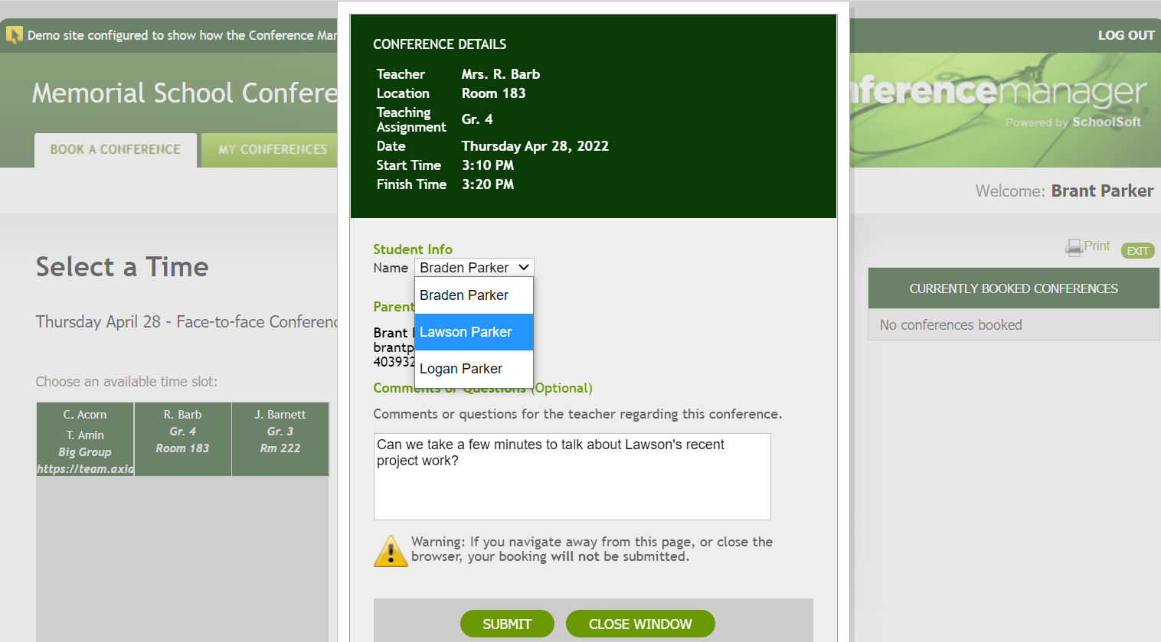
Notes:
This is the booking form they complete and submit. Once submitted, the booking in show in the applicable teacher’s schedule. In this case, an appointment is being booked for Lawson Parker with Mrs. Rhianna Barb at 3:10 PM on April 28.

Slide 11
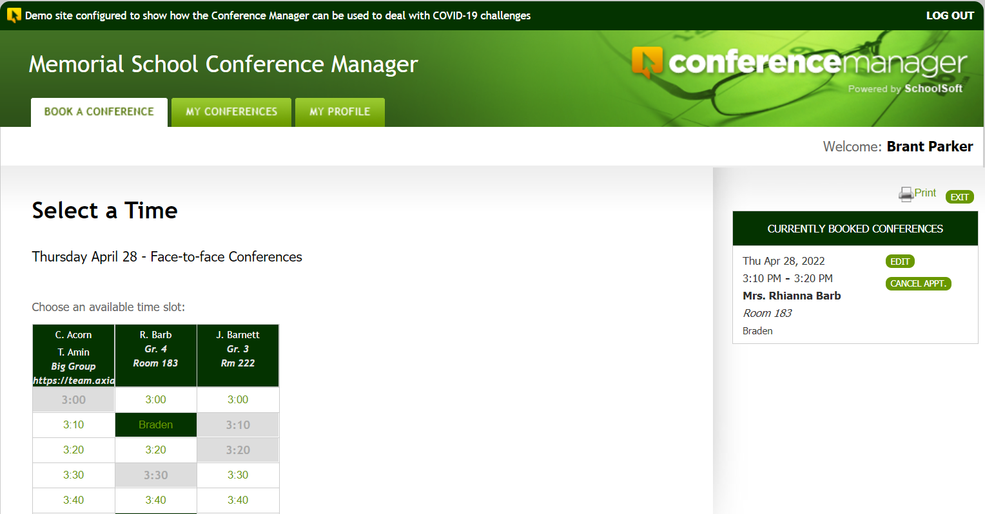
Booked conferences show here.
A confirmation email is also emailed to the parent.
Notes:
Once the appointment is booked it shows up in the parent window. The parent can also click the MY CONFERENCES tab to get slightly more detailed information.

Slide 12
The Teacher Schedule

Slide 13
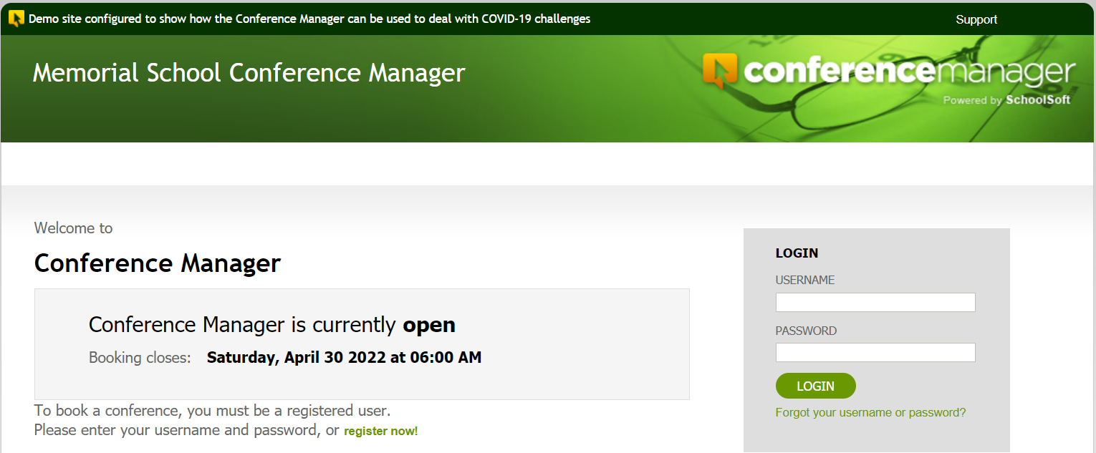
Access the Conference Manager
Enter the school’s URL for the Conference Manager log-in page
Notes:
Teachers have to go to the application URL to log in. It is important that all teachers confirm they can log in well before conferences begin. You might want to ask everyone to do this within a day of your meeting.

Slide 14
Login credentials
Your password was sent to you in an email from
appointments@schoolsoft.com
From: appointments@schoolsoft.com
Sent: September 4, 2021 2:40 PM
To: Ima Teacher iteacher@schooldistrict.edu
Subject: Schoolsoft Conference Manager – New Account
Hello Ima,
Heather Fox has set up your staff account for the SchoolSoft Conference Manager.
You can access the application at https://memorial.schoolsoft.com/login.jsf.
Login in using your username iteacher and password $7hY%hAm
Thanks you for using the SchoolSoft Conference Manager.

Slide 15
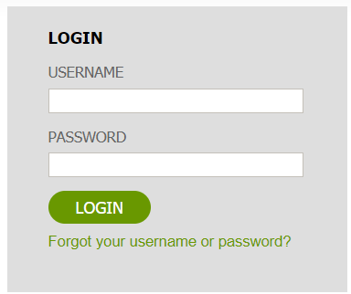
Forgot or can’t find your password?
Click the Forgot Password link on
the log-in page to reset it.

Slide 16
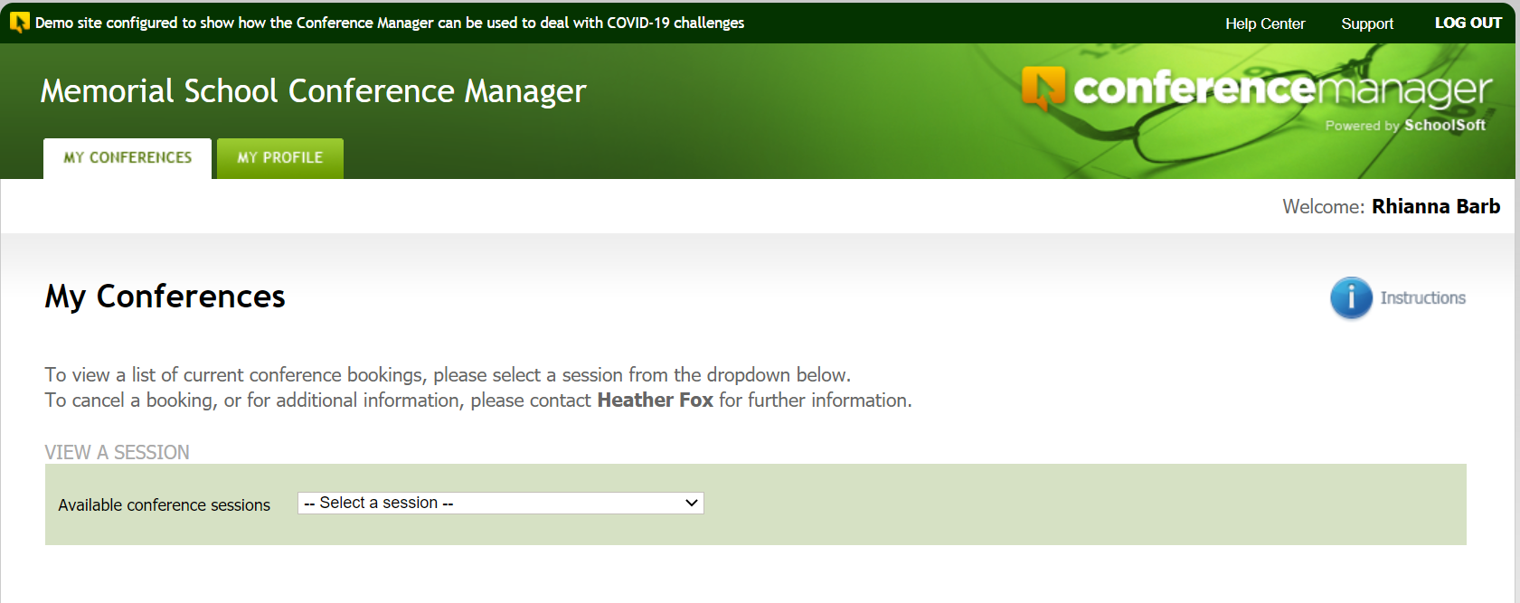
Access to help resources
Quick start guide
Notes:
Once logged in you can access the help center and a quick start guide.

Slide 17
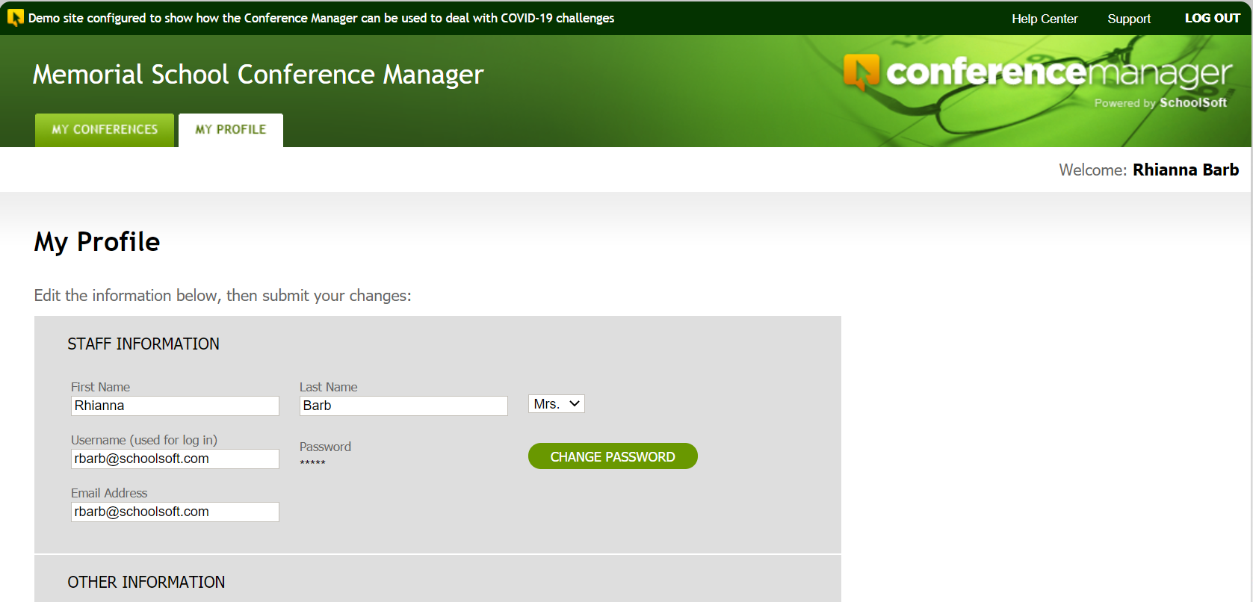
Your profile (name, teaching assignment, location, change password and optional note to parents)
Notes:
The profile should be double checked by all teachers before conference bookings begin to ensure the teaching assignment, conference location and other information is accurate.

Slide 18
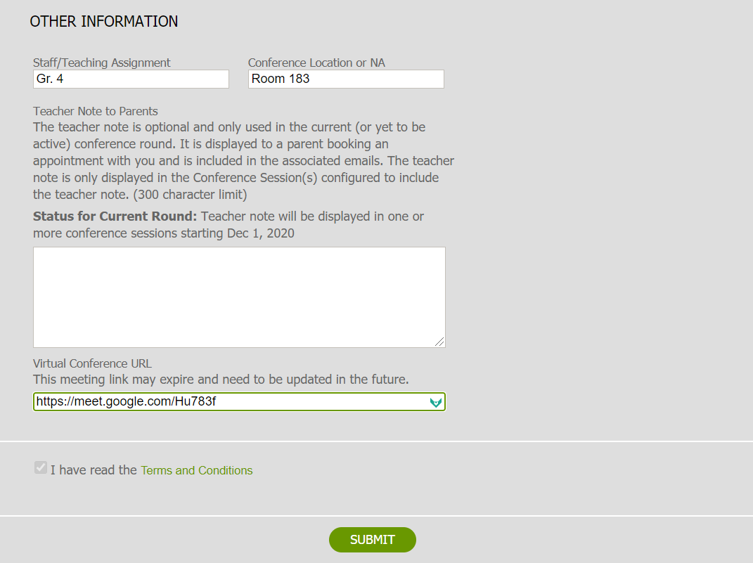
Depending upon the school’s configuration of conferences, you may be able to have a message sent to all parents who will or have booked a conference with you.
An online meeting link is entered only if conferences are configured to occur online.
Notes:
The can also include a note to parents who have or will be booking a teacher. This is useful if the teacher wants to provide a specific message that pertains only to a parent making a booking with the teacher. This message is sent as an updated conference confirmation form. The virtual conference URL is only accessed from the teacher profile if the school opts to do virtual conferences.

Slide 19
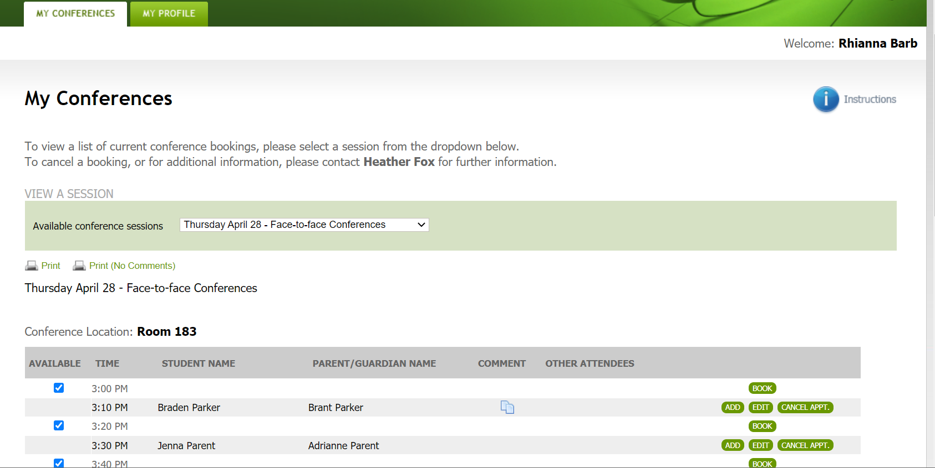
Select schedule to view
Notes:
The teachers starts by selecting the desired schedule from the drop down list of all conference schedules.

Slide 20
Print schedule
Notes:
A hard copy can be printed if desired by the teacher.

Slide 21

Optional parent question/comment
shows if you hover over icon. Parents who want a virtual or telephone conference will indicate that here.
Can we take a few minutes to discuss Lawson’s recent project work?
The school can configure conferences so the teacher
can remove the check to make a time slot unavailable
Notes:
If there is a comment or question the teacher entered, then the comment icon.

Slide 22
Use BOOK button only if you are booking an appointment for a parent
ADD button allows you to invite another available staff member to the appointment and places the appointment in their schedule
CANCEL APPT. will remove the booking and alert the parent of the cancellation
Notes:
In most cases the teachers will not need to use these buttons, but it is important to point them out.

Slide 23
Log out when exiting

