Slide 1
Conference Manager*
Overview for teachers
*Configured with PowerSchool Integration
Notes:
IMPORTANT: Please note that Virtual Conferences must be checked off by the System Admin as an option in the SCHOOL PROFILE in order for virtual conference functionality to be available in the Conference Manager.

Slide 2
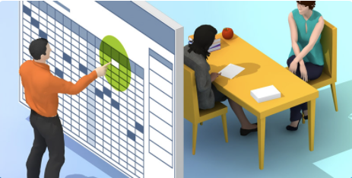
Parent Booking Process
Notes:
IMPORTANT: Please note that Virtual Conferences my be checked off by the System Admin as an option in the SCHOOL PROFILE in order for virtual conference functionality to be available in the Conference Manager.

Slide 3
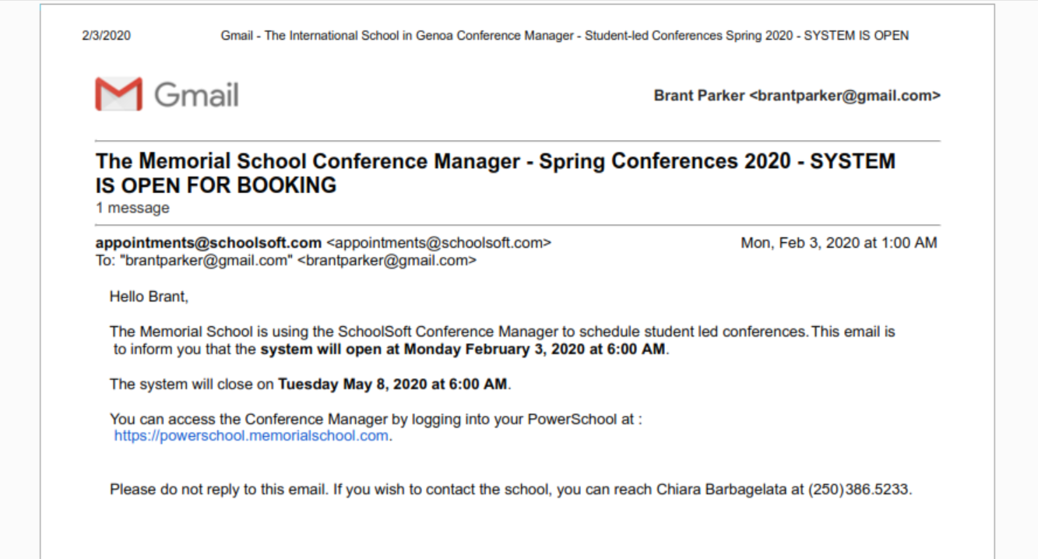
The Memorial School Conference Manager
is open for booking
April 9, 2022 12:05 AM
Memorial School is using the Conference Manager to schedule parent conferences. This email is to inform you that the system will open on Wednesday April 10, 2022 at 8:00 AM.
The system will close on Friday April 29, 2022 at 3:00 AM
You can access the Conference Manager by logging into your PowerSchool account at:
https://memorial.powerschool.com
Please do not reply to this email. If you wish to contact the school, you can reach Heather Fox at 408-555-1212.
Notes:
The Conference Manager is most likely configured to send an email to parents informing them when they can book conferences.

Slide 4
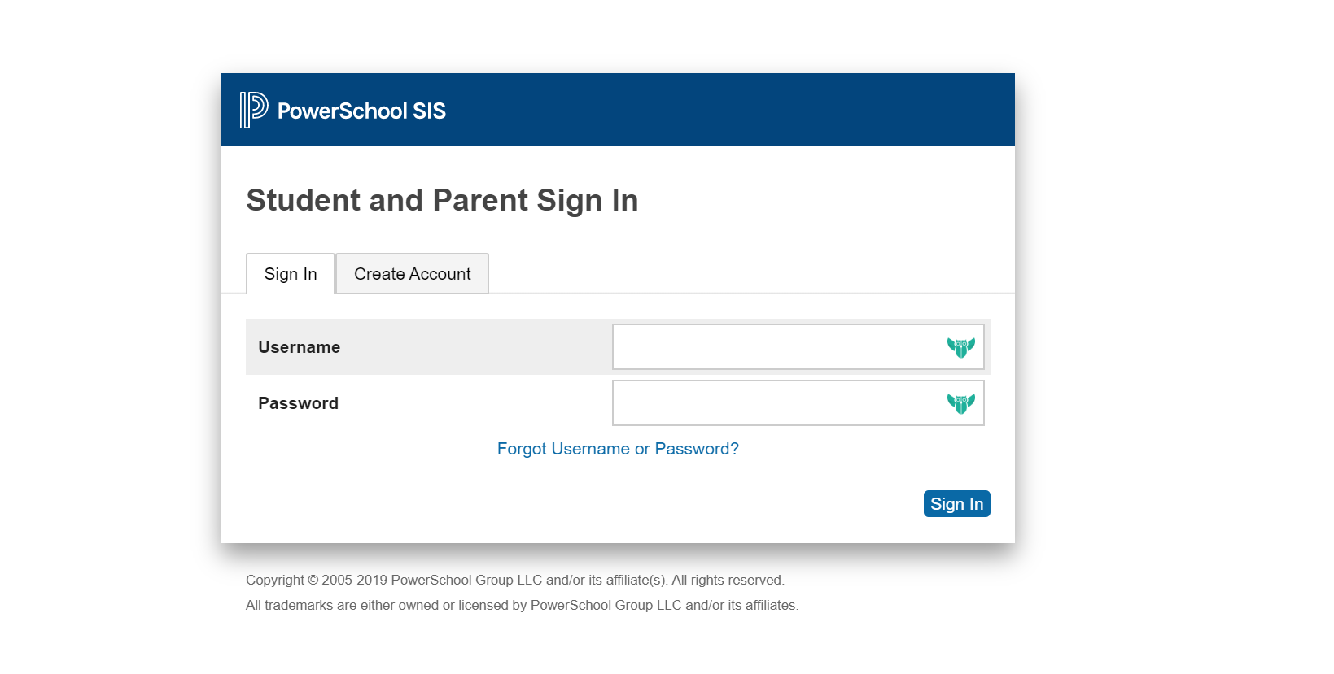
Notes:
Link in the email takes the parent to PowerSchool to log in

Slide 5
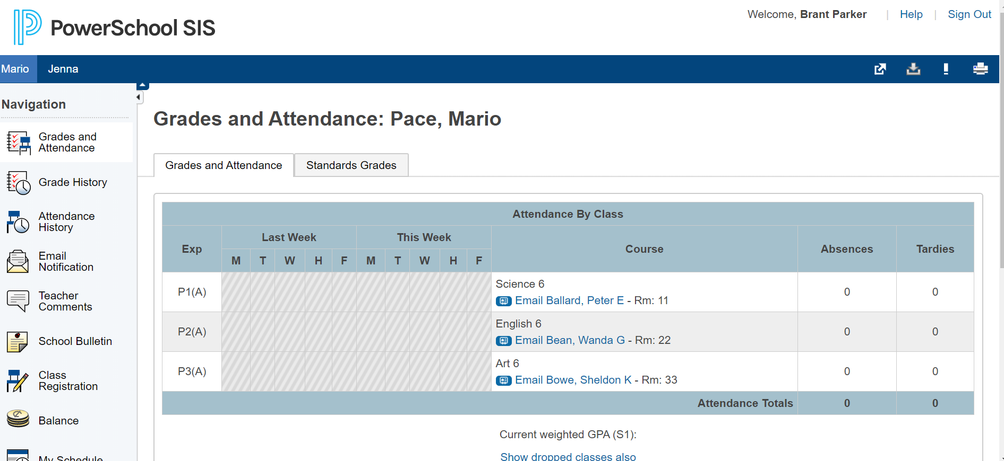
Notes:
This screenshot shows how parents use the application launcher in PowerSchool to access the Conference Manager.

Slide 6
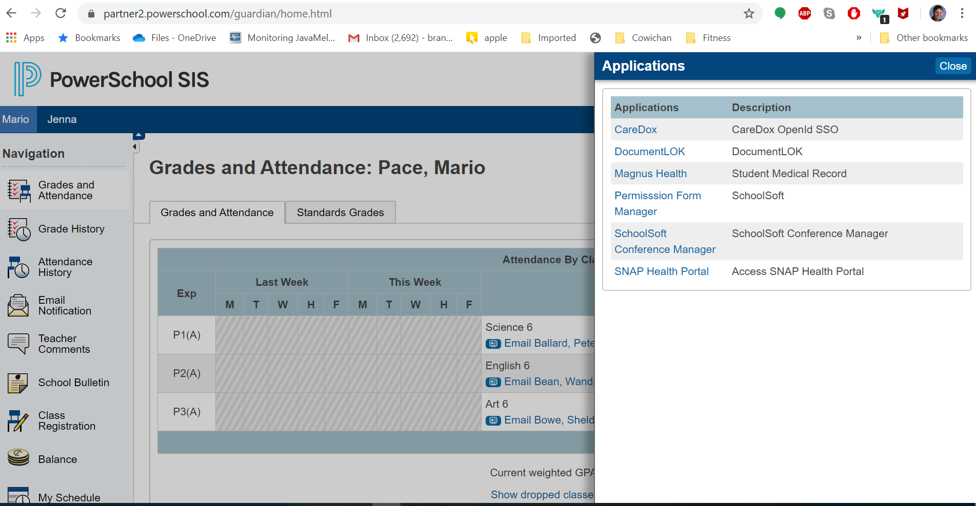
Notes:
And select the Conference Manager from the menu.

Slide 7
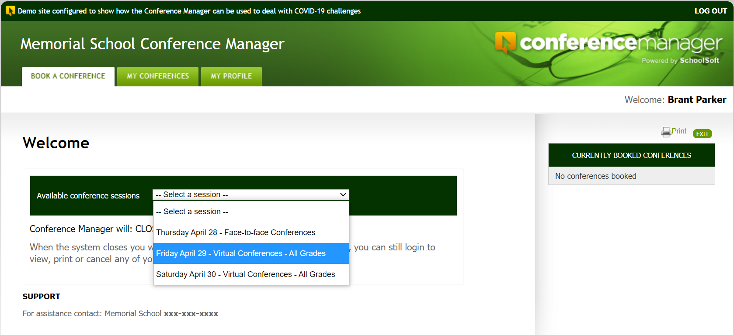
Once logged in the parent starts the booking process by using the conference session drop down list and selecting the date they are interested in making a booking
Notes:
The parent is then in the Conference Manager and can book their appointment(s) by selecting the date they wish to schedule an appointment for. If there are multiple schools in your district using the Conference Manager and the parent has a child in more than one school, after selecting the Conference Manager the parent would see the list of schools their children attend and select the applicable school. A screen shot of the school selection is not included here.

Slide 8
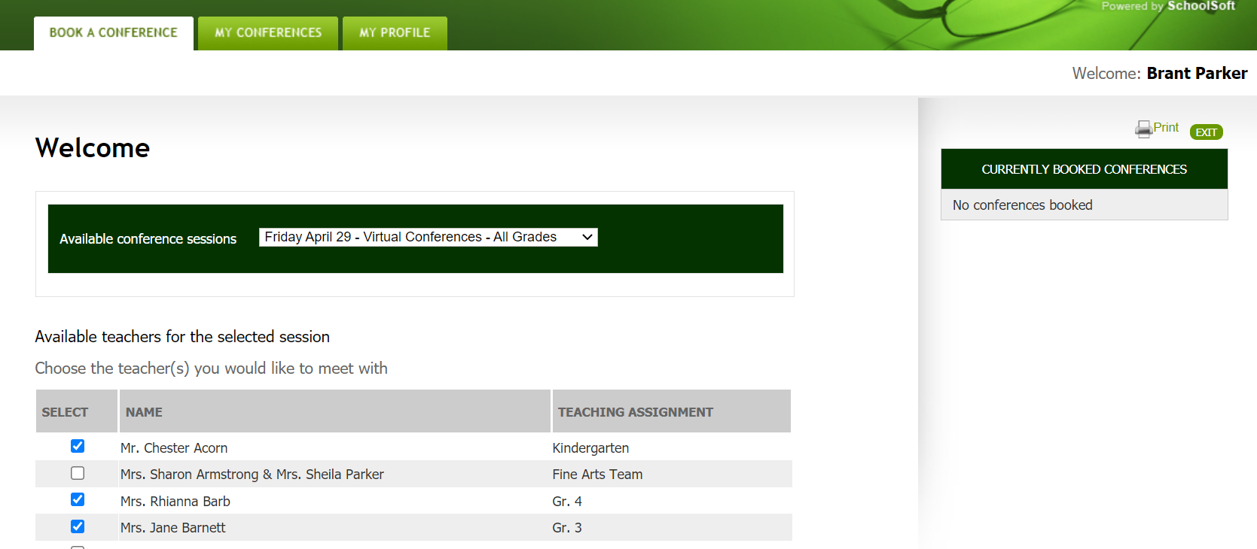
Notes:
Parents use checks to select the teacher(s) they want to book an appointment with.

Slide 9
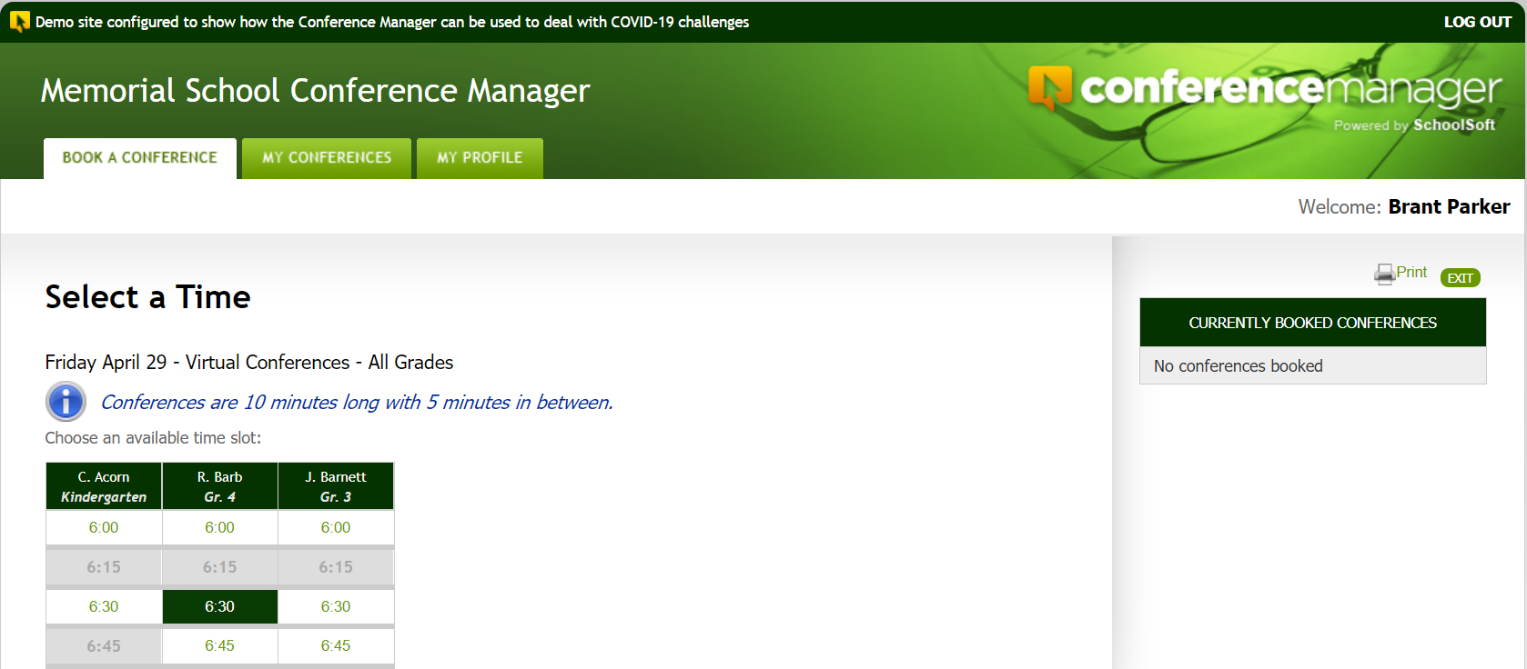
6:30 available time slot selected
Notes:
The schedules of the teachers are shown. Blocks of time that are booked by other parents or reserved are greyed out. Available blocks can be clicked on and the parent can complete a booking.

Slide 10
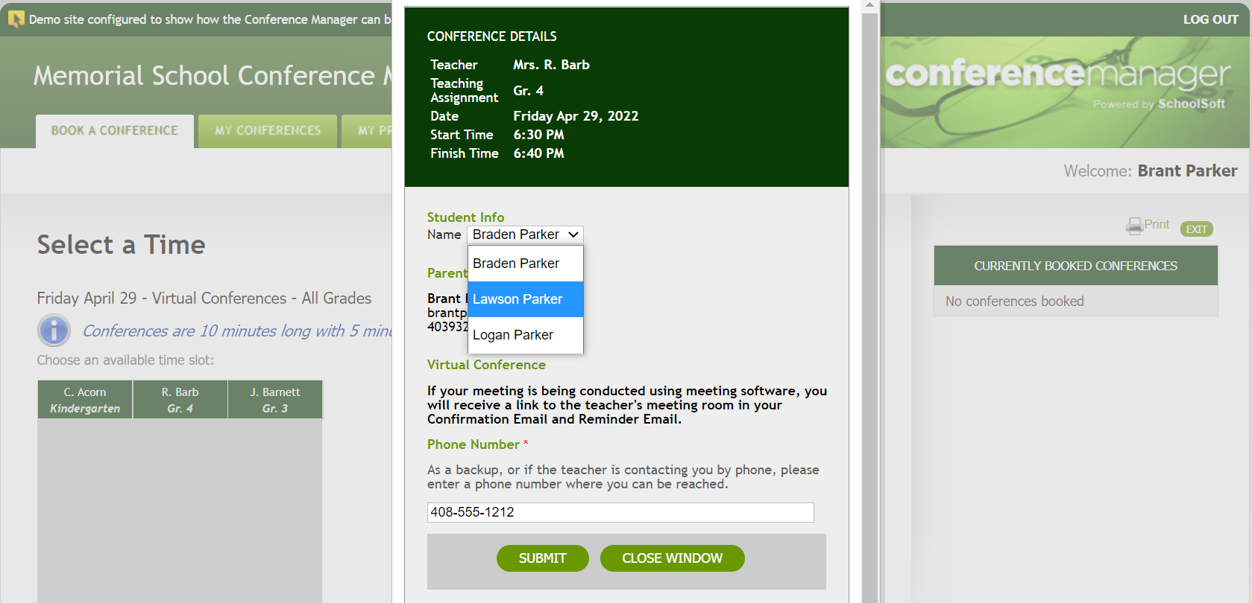
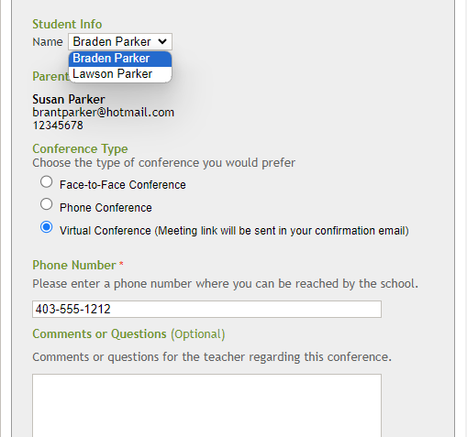
The booking may be for a format (face-to-face, online or phone) or may be configured so the parent has choice in the conference type. This screenshot shows making a booking for a virtual conference.
Face-to-face, on-line or phone conferences formats are supported. Schools may restrict parents to one conference type or allow parents to select from two or all three. In this instance all three are permitted and the parent has indicated their preference for a virtual conference online.
Parents will be required to enter a phone number in the event there is a technical issue or the school needs to contact them. This number will appear on the teacher’s schedule.
Notes:
This is the booking form the parent completes and submits. Once submitted, the booking in show in the applicable teacher’s schedule. In this case, an appointment is being booked for Braden Parker with Mrs. Rhianna Barb at 6:30 PM on April 29.

Slide 11
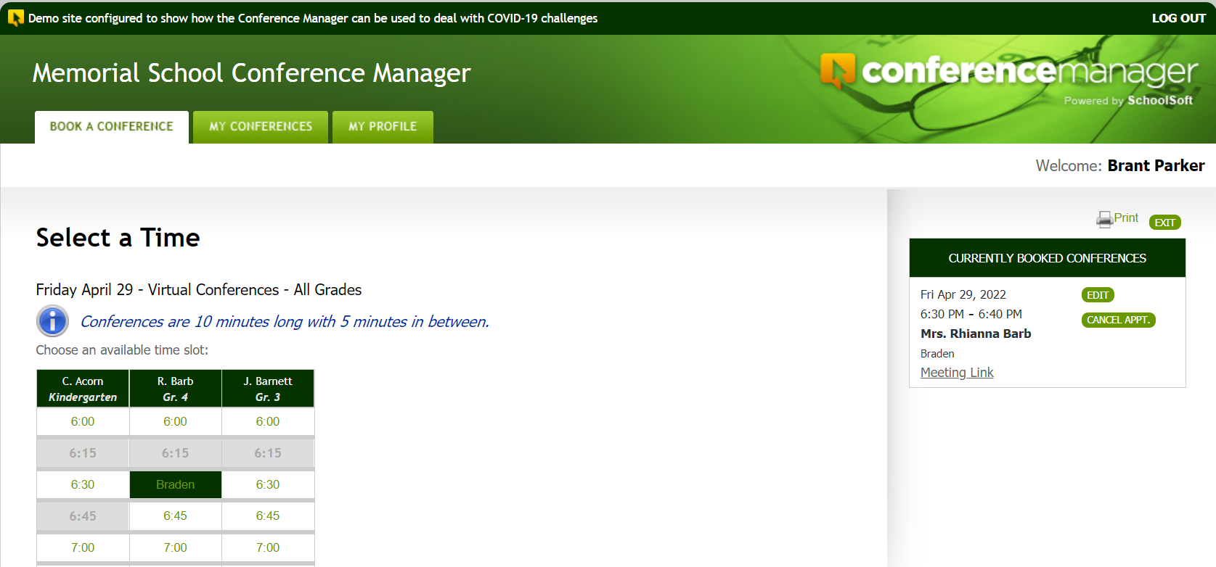
Booked conferences show here.
Confirmation of booking is also emailed to the parent. It contains the same meeting link they can access here.
Notes:
Once the appointment is booked it shows up in the parent window. The parent can also click the MY CONFERENCES tab to get slightly more detailed information.

Slide 12
The Teacher Schedule

Slide 13
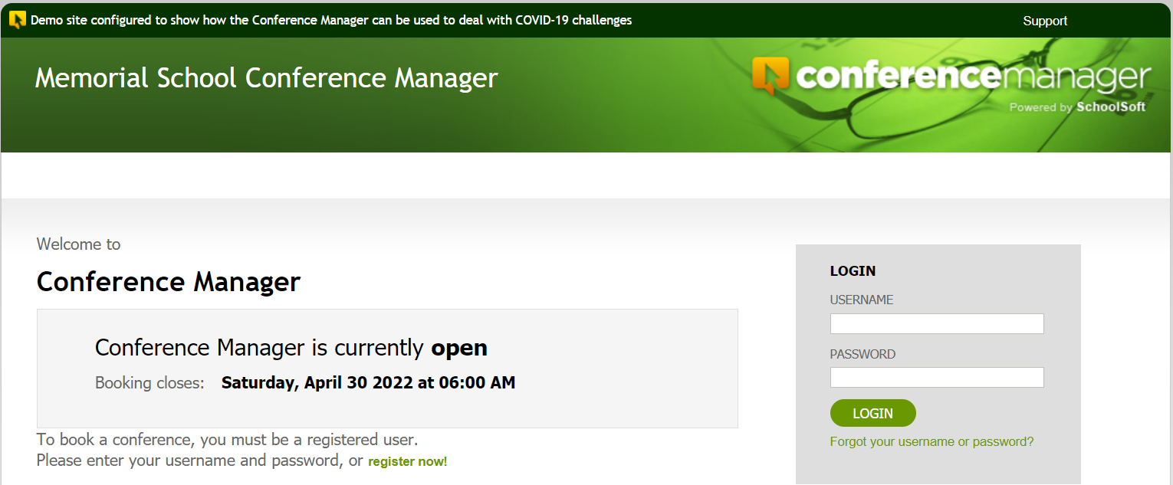
Access the Conference Manager
Enter the school’s URL for the Conference Manager staff log-in page
Notes:
Teachers have to go to the application URL to log in. It is important that all teachers confirm they can log in well before conferences begin. You might want to ask everyone to do this within a day of your meeting.

Slide 14
Login credentials
Your password was sent to you in an email from
appointments@schoolsoft.com
From: appointments@schoolsoft.com
Sent: September 4, 2021 2:40 PM
To: Ima Teacher iteacher@schooldistrict.edu
Subject: Schoolsoft Conference Manager – New Account
Hello Ima,
Heather Fox has set up your staff account for the SchoolSoft Conference Manager.
You can access the application at https://memorial.schoolsoft.com/login.jsf.
Login in using your username iteacher and password $7hY%hAm
Thanks you for using the SchoolSoft Conference Manager.

Slide 15
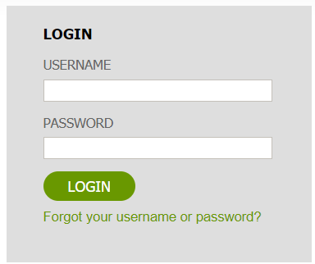
Forgot or can’t find your password?
Click the Forgot Password link on
the log-in page to reset it.

Slide 16
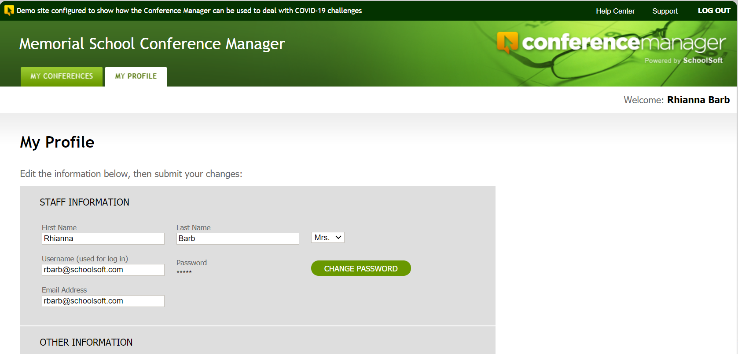
Your profile is where you can enter information relating to you, your account, note to parents booking and the online meeting URL that you will be using for your virtual conferences.
Notes:
The profile should be double checked by all teachers before conference bookings begin to ensure the teaching assignment, conference location and other information is accurate.

Slide 17
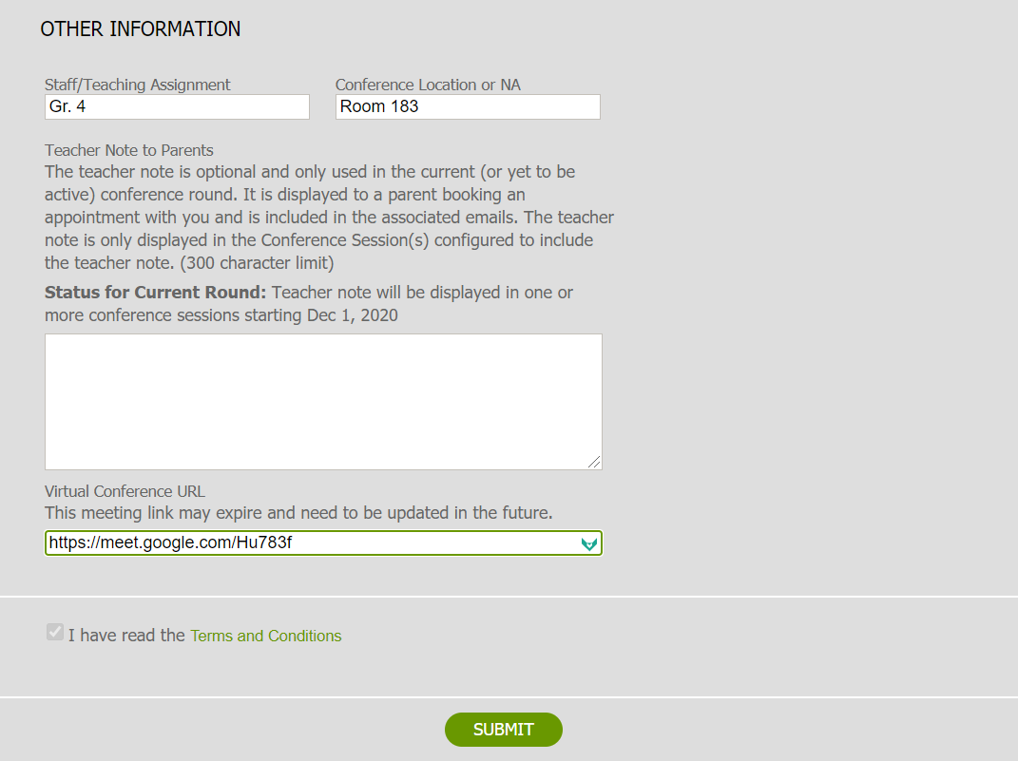
With virtual conferences your physical conference location is not displayed.
Depending upon the school’s configuration of conferences, you may be able to have a message sent to all parents who will or have booked a conference with you.
If virtual conferences are being conducted the will need to create an online meeting using the school’s online meeting application and enter the URL so it can be shared with parents who book a conference.
Notes:
The can also include a note to parents who have or will be booking a teacher. This is useful if the teacher wants to provide a specific message that pertains only to a parent making a booking with the teacher. This message is sent as an updated conference confirmation form. The virtual conference URL is only accessed from the teacher profile if the school opts to do virtual conferences.

Slide 18
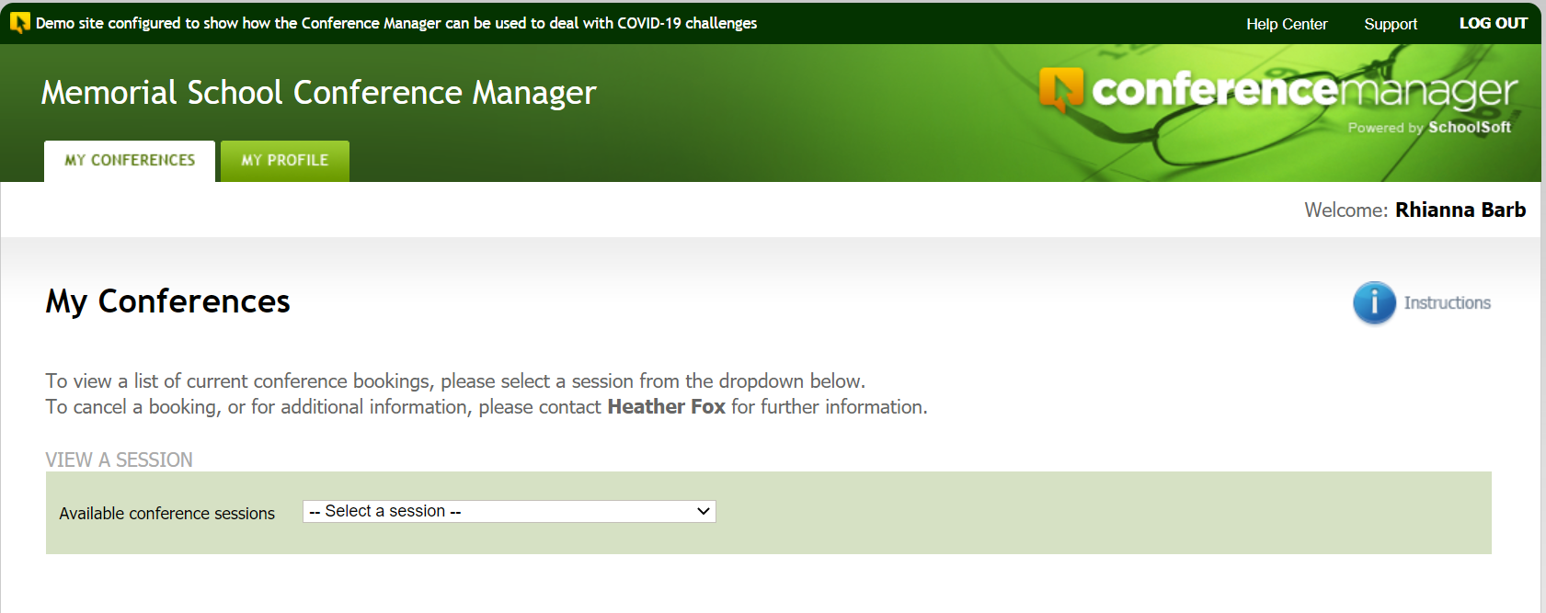
The MY CONFERENCES tab lets you access your schedule
Access to help resources
Quick start guide
Notes:
Once logged in you can access the help center and a quick start guide.

Slide 19
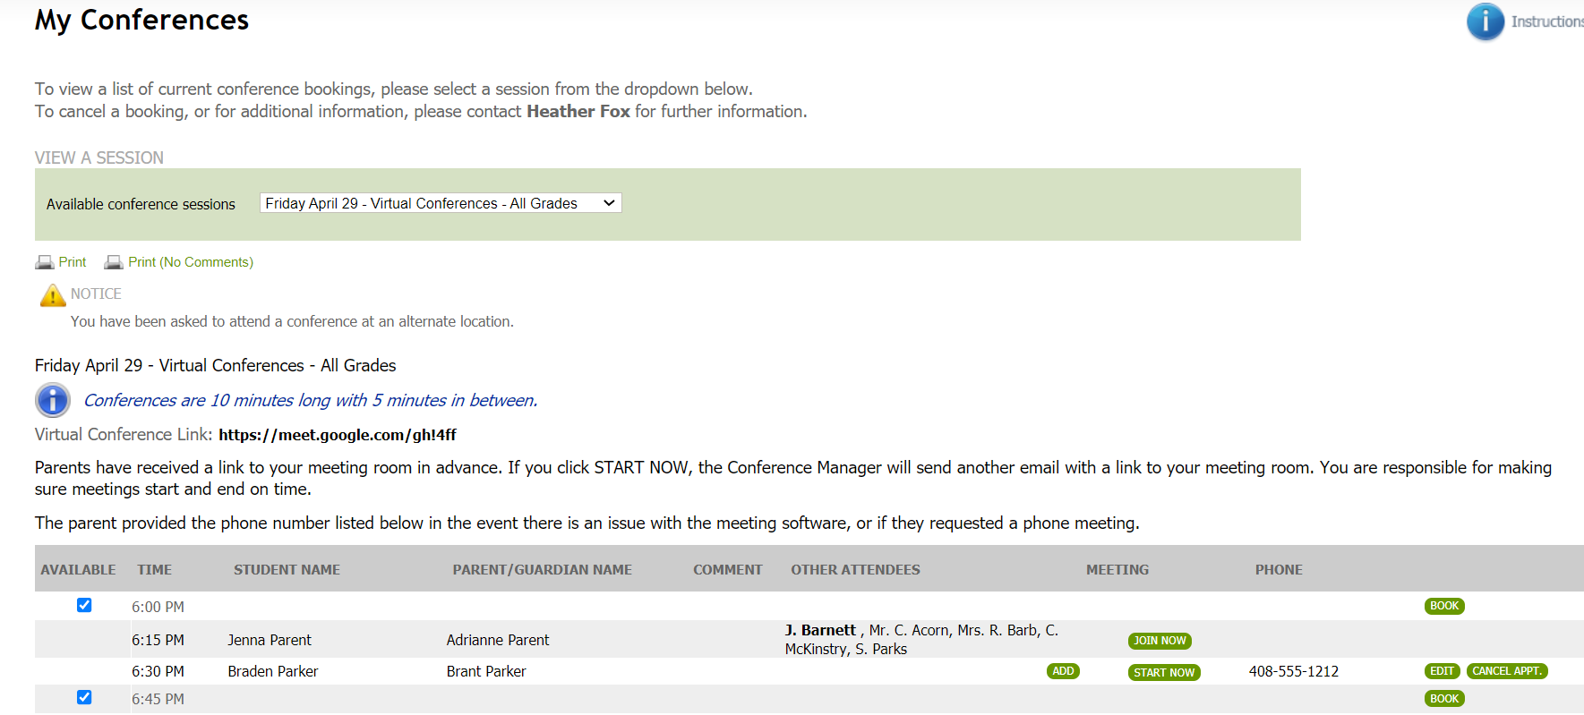
Rhianna Barb
Drop-down list allows you to select a schedule to view
Notes:
The teachers starts by selecting the desired schedule from the drop down list of all conference schedules.

Slide 20
Rhianna Barb
Print schedule
Notes:
A hard copy can be printed if desired by the teacher.

Slide 21

Rhianna Barb
Use BOOK button only if you are booking an appointment for a parent. This button may not be displayed if teachers do not book appointments.
The school can configure conferences so the teacher
can remove the check to make a time slot unavailable
Notes:
If there is a comment or question the teacher entered, then the comment icon.

Slide 22
Rhianna Barb
A teacher can invite other available and required staff to a specific conference using the ADD button
When additional staff are invited to a meeting, they appear here. The initiating teacher is in bold, others are invitees.
If you are a conference invitee, you use the JOIN NOW button to enter into the virtual conference

Slide 23
Rhianna Barb
In most cases parents will already have used the online meeting application link sent in their confirmation email and be waiting for the teacher to admit them to the meeting. However, if the parent is not waiting online, the teacher can click the START NOW button to send notification that the meeting is ready to begin.
The teacher’s virtual conference link in their profile is displayed here.
Notes:
In most cases the teachers will not need to use these buttons, but it is important to point them out.

Slide 24
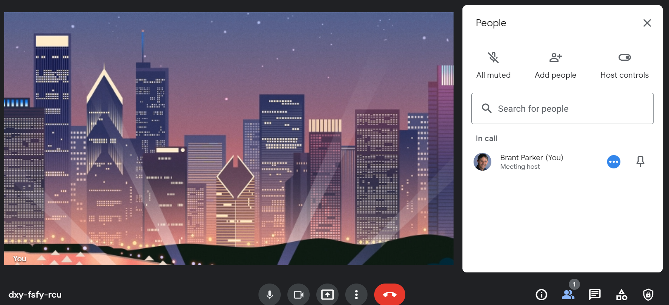
Teachers use the school’s online meeting platform to manage the admission of scheduled parents to the online conference. Keeping the Conference Manager open in a browser tab makes it easy to reference which parents they will be meeting with next.

Slide 25
Log out when exiting

